Slide 1
Data Movement Hardware & Software
Vernard Martin, Solutions Architect and Infrastructure Team Lead Scientific Computing & Bioinformatics Services Office of Advanced Molecular Detection Centers for Disease Control & Prevention
This document is a result of work by volunteer LCI instructors and is licensed under CC BY-NC-ND 4.0 (https://creativecommons.org/licenses/by-nc-nd/4.0/).

Slide 2
Data Transfer Node
A DTN server is made of several subsystems. Each needs to perform optimally for the DTN workflow:
Storage: capacity, performance, reliability, physical footprint
Networking: protocol support, optimization, reliability
Motherboard: I/O paths, PCIe subsystem, IPMI
Chassis: adequate power supply, extra cooling
Note: the workflow we are optimizing for here is sequential reads/write of large files, and a moderate number of high bandwidth flows.
We assume this host is dedicated to data transfer, and not doing data analysis/manipulation
Notes:
What composes a DTN
A DTN server is made of several subsystems:
Storage
Networking
Motherboard
Chassis
Each needs to perform optimally for the DTN workflow—any of these things components can be the bottleneck if you’re not careful
There is always one thing that prevents you from going faster—eliminate as many bottlenecks as possible with hardware as a start
Only job is big sequential writes and big sequential reads—large file IO
_______________
Also please note the workflow we are optimizing for here is
sequential reads/write of large files, and a moderate number of high bandwidth flows.
A Data Transfer Node is not a processing, rendering, server. Its only workflow is:
Sender host:
1) read data from the storage subsystem
2) send it to the receiver host
Receiver host:
1) read data from the network
2) write it onto the storage subsystem

Slide 3
Motherboard and Chassis selection
Chassis
Extra cooling (for future expansion, unless you buy the system full)
Make sure the power supply is adequate
Motherboard/CPU
Cascade Lake/Alder lake/Raptor Lake or newer CPU architecture (e.g. for 10/40G, you can get away with a reasonably modern machine)
High clock rate better than high core count for DTNs – max this out
Faster QPIC for communication between processors
PCI Gen 3 or newer (40G and 100G requires PCI Gen 3)
Memory speed – faster is better, more is better
We recommend 128GB of RAM for a DTN node
Balance CPU,RAM, & I/O means sometimes more nodes rather than larger ones
IPMI for remote management (optional but really not)
Notes:
The questions to ask while making motherboard selection are:
How many cores do you need?
And at what speed ?
What kind of remote access (for maintenance) do you need?
In general, for your motherboard you want to make sure you have
PCI Gen3 capabilities
plenty of memory (both speed and space)
For example,
Intel’s Sandy/Ivy Bridge (Ivy Bridge is about 20% faster) CPU architecture provides these features,
An inadequate motherboard can become a major bottleneck.
It is, then, very important to correctly select it.

Slide 4
PCI Slot Considerations
PCI slots are defined by:
Slot width:
Physical card and form factor
Max number of lanes
Lane count:
Maximum bandwidth per lane
Most cards will run slower in a slower slot
Not all cards will use all lanes
Notes:
When thinking about the PCI slots, need to ask”
How many PCI cards will you need ? How many lanes each ?
What is the aggregate throughput you need on your PCI cards ?
PCI slots are defined by slot width and lane count
Basically just need to make sure you have the right number for the right PCI slots
RAID controllers, NICs, and anything connected to the network goes through the PCI cards
If its not fast enough, this will be your bottleneck
________________________
Form Factor: This is the length of the slots, referred as the number of PCI lanes it can support, and cards. A 16 lane controller is twice as long as an 8 lane controller.
Number of wired lanes: not all lanes of the slot may be wired. Some 8 lane controller may only have 4 lanes wired.
Bridges
PCIe 2.0 is 500 MB/sec per lane. A typical host supports 8 lane (x8) slots but only runs at half speed: 4 GB/sec. A high-end host might have 16 lane (x16) slots, or up to 8 GB/sec.
PCIe 3.0 = Double the above
RAID controllers, NICs and anything connected to the network goes through PCIe—if its not fast enough, this will be the bottleneck.
Make sure the motherboard you select has the right number of slots with the right number of lanes for you planned usage.

Slide 5
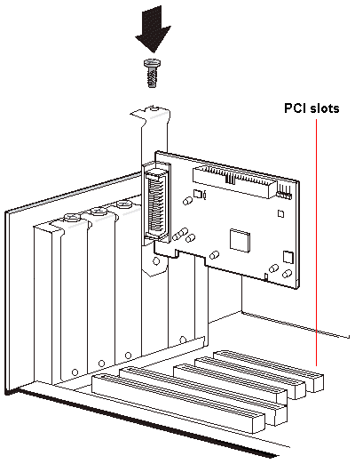
PCI Slot Considerations
Card being inserted:
x8 Slot Width
Slot being used:
x8 Slot Width
Wider Slot (bottom):
x16 Slot Width
Notes:
When thinking about the PCI slots, need to ask”
How many PCI cards will you need ? How many lanes each ?
What is the aggregate throughput you need on your PCI cards ?
PCI slots are defined by slot width and lane count
Basically just need to make sure you have the right number for the right PCI slots
RAID controllers, NICs, and anything connected to the network goes through the PCI cards
If its not fast enough, this will be your bottleneck
________________________
Form Factor: This is the length of the slots, referred as the number of PCI lanes it can support, and cards. A 16 lane controller is twice as long as an 8 lane controller.
Number of wired lanes: not all lanes of the slot may be wired. Some 8 lane controller may only have 4 lanes wired.
Bridges
PCIe 2.0 is 500 MB/sec per lane. A typical host supports 8 lane (x8) slots but only runs at half speed: 4 GB/sec. A high-end host might have 16 lane (x16) slots, or up to 8 GB/sec.
PCIe 3.0 = Double the above
RAID controllers, NICs and anything connected to the network goes through PCIe—if its not fast enough, this will be the bottleneck.
Make sure the motherboard you select has the right number of slots with the right number of lanes for you planned usage.

Slide 6
PCI Bus Considerations
Example:
10GE NICs require an 8 lane PCIe-2 slot
40G/QDR NICs require an 8 lane PCIe-3 slot
100G NICs (ex. Mellanox) requires a 16 lane PCIe-3 slot
Most RAID controllers require an 8 lane PCIe-2 slot
Fusion-IO cards may require a 16 lane PCIe-3 slot
Notes:
Make sure the motherboard you select has the right number of slots with the right number of lanes for you planned usage.
For example, some typical slot requirements are:
10GE NICs require an 8 lane PCIe-2 slot
40G/QDR NICs require an 8 lane PCIe-3 slot
Most RAID controllers require 8 lane PCIe-2 slot
A high-end Fusion IO ioDrive may require a 16 lane PCIe-3 slot
Here are some possible motherboards to consider
SuperMicro X9DR3-F
Sample Dell Server (Poweredge r320-r720)
Sample HP Server (ProLiant DL380p gen8 High Performance model)
Supermicro is in our reference designs (posted on fasterdata)
But other vendors have servers that can be used as DTNs
Some institutions require long-term support contracts for servers so they tend to want to go with an established vendor (Dell, HP etc.)
All these are capable of 40G though
________________________

Slide 7
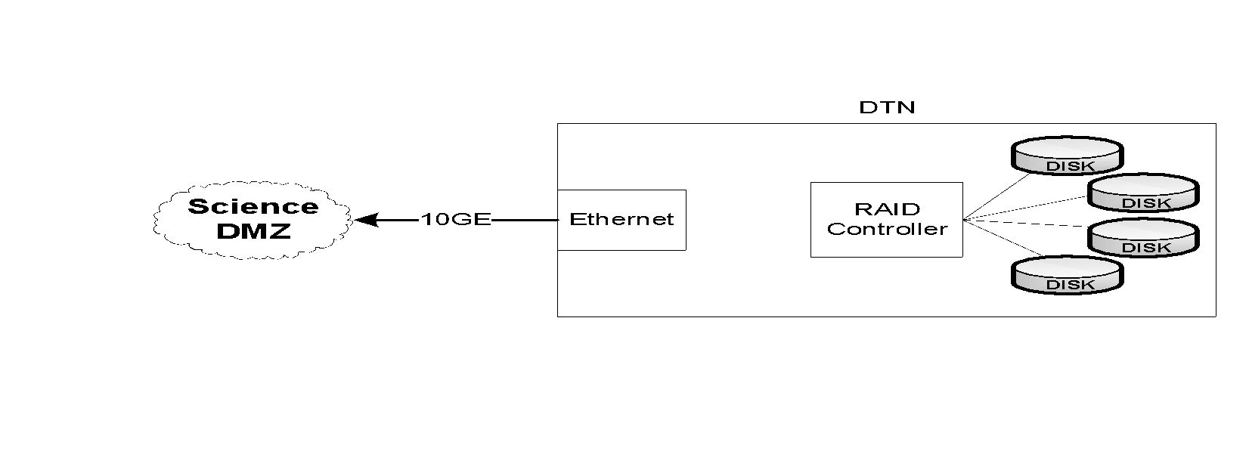
-Storage Architectures - Internal
DTN with internal RAID is self-contained
Same CPU, RAM, etc. as DTN with external storage
No external dependencies for storage
Deployable anywhere
Limited scalability
Storage managed locally (you get whatever tools the RAID controller gives you)
Notes:
Next is: what does the storage look like for a DTN?
There are various ways you can bring storage into or to your server
3 main classes
The 1st and most common DTN choice is local storage within the DTN
Perks:
no external dependencies
deployable anywhere
But
limited scalability
and only tools for managing storage come from RAID controllers
_____________
Local storage: the storage system (just a bunch of drives / JBOD) is packaged with the server. That can from 12 drivers up to 48 drives depending on vendor/model. In addition, external chassis with more drives can be added, connected to the server with SAS or FC. This is ideal for standalone servers since it does not require plumbing for the storage subsystem.
However, maintenance is typically more difficult since it does not have all the tooling that usually comes with storage systems.

Slide 8
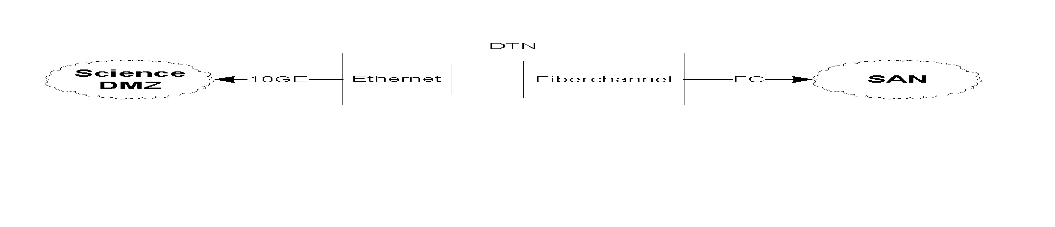
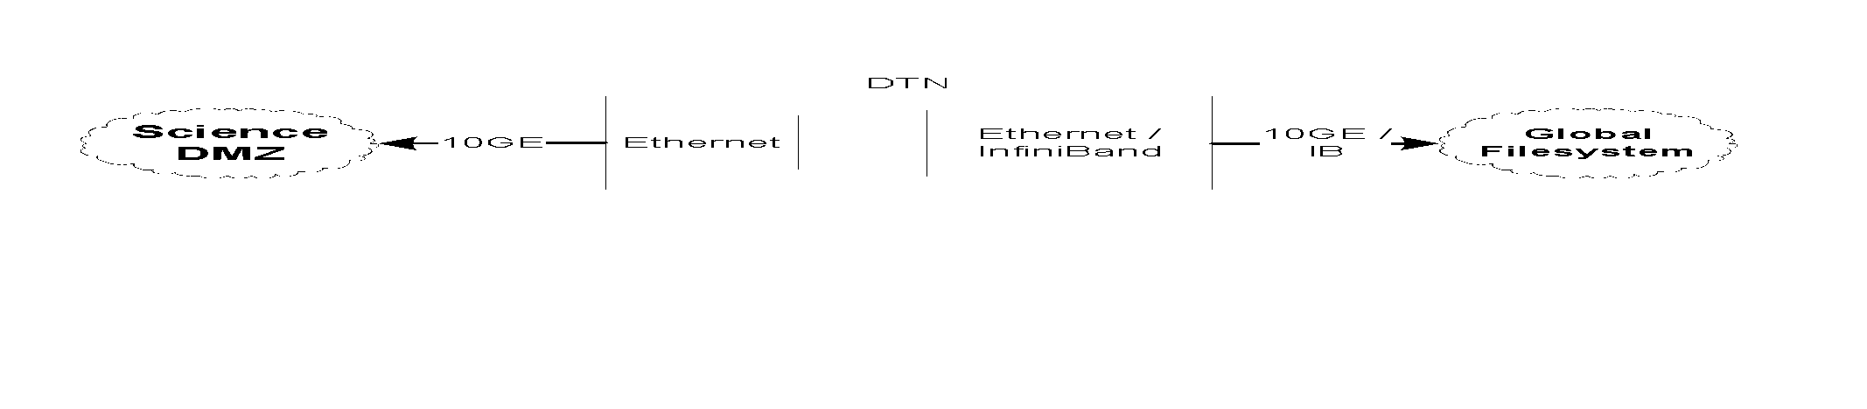
Storage Architectures - External
These are essentially the same from a DTN host design perspective
IB, Ethernet, or Fibrechannel card connects to external storage
Other system components (CPU, RAM, etc.) the same
Central storage management, greater flexibility
Integration with other large-scale resources (e.g. HPC)
Notes:
Next two classes are the same from a systems perspective
(main different from a workflow perspective—i.e. double copy workflow for SANs but not with distributed/global file systems)
We see these storage architectures in DTNs at data and HPC facilities
But whatever you choose for storage will depend on your environment, requirements, and resources.
______________________
System reasoning: what kind of card used on the backend to the storage system—FC/Ethernet/Inifiniband look the same
But the workflow is what’s different
No block device communication between DTN kernel Global fs
For SAN and internal disks—DTN kernel sees it as “owning”/managing blocks in SAN or RAID
_____________________________
Distributed file systems—high quality of service
much more reliable
easy to manage
however, typically performance is much lower because they are usually a shared system—don’t know the workload of other users—possibility of contesting traffic
i.e., we see this at data centers/supercomputers
they do have bottlenecks. I/O is the storage controller (EMC is limited to 8G right now)
Same I/O capacity but no bottleneck with infiniband connections.
enterprise level system
IB
56 G/link and easy to aggregate
reliable networking—no packet loss
fairly cheap
Distributed filesystem: this is similar to the storage system, except that the exported volumes are not RAW but file system (PNFS, Lustre, GPFS…). This set up is typical of a tiered system: data is acquired and processed, and stored. Then the DTN read from the shared storage.
Storage Systems: These are usually more massive systems (EMC, Netapp, DDN, etc) providing raw volumes to servers. The connectivity is usually fiber, but it can also be infiniband and ethernet.
This class benefits storage capacity.
POINT: look at what your infrastructure requirements are
how much capacity do you need for the next 3 years—will your system scale the way you want?
how reliable does your storage have to be—source of truth or is it a pain to resend the data if a disk goes down? (i.e., choose your RAID appropriately)
performance of storage what you need? If its 10G—laptops won’t do that
don’t need to invest in super fast storage if you only want to use laptops

Slide 9
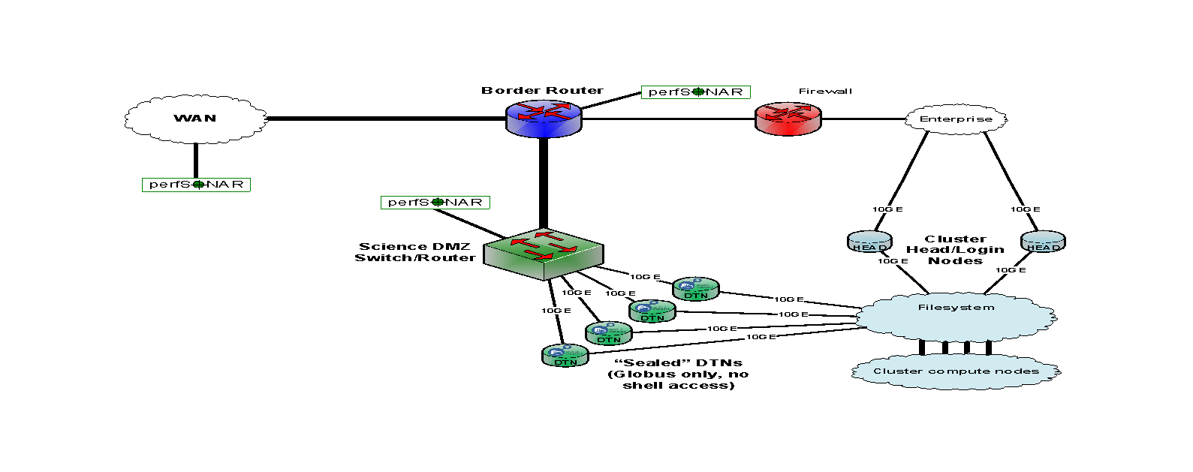
DTNs in a Facility
10G
10G
10G
40G/100G
Downstream
Notes:
Next two classes are the same from a systems perspective
(main different from a workflow perspective—i.e. double copy workflow for SANs but not with distributed/global file systems)
We see these storage architectures in DTNs at data and HPC facilities
But whatever you choose for storage will depend on your environment, requirements, and resources.
______________________
System reasoning: what kind of card used on the backend to the storage system—FC/Ethernet/Inifiniband look the same
But the workflow is what’s different
No block device communication between DTN kernel Global fs
For SAN and internal disks—DTN kernel sees it as “owning”/managing blocks in SAN or RAID
_____________________________
Distributed file systems—high quality of service
much more reliable
easy to manage
however, typically performance is much lower because they are usually a shared system—don’t know the workload of other users—possibility of contesting traffic
i.e., we see this at data centers/supercomputers
they do have bottlenecks. I/O is the storage controller (EMC is limited to 8G right now)
Same I/O capacity but no bottleneck with infiniband connections.
enterprise level system
IB
56 G/link and easy to aggregate
reliable networking—no packet loss
fairly cheap
Distributed filesystem: this is similar to the storage system, except that the exported volumes are not RAW but file system (PNFS, Lustre, GPFS…). This set up is typical of a tiered system: data is acquired and processed, and stored. Then the DTN read from the shared storage.
Storage Systems: These are usually more massive systems (EMC, Netapp, DDN, etc) providing raw volumes to servers. The connectivity is usually fiber, but it can also be infiniband and ethernet.
This class benefits storage capacity.
POINT: look at what your infrastructure requirements are
how much capacity do you need for the next 3 years—will your system scale the way you want?
how reliable does your storage have to be—source of truth or is it a pain to resend the data if a disk goes down? (i.e., choose your RAID appropriately)
performance of storage what you need? If its 10G—laptops won’t do that
don’t need to invest in super fast storage if you only want to use laptops

Slide 10

DTNs in a Facility – Network Paths
10G
10G
10G
40G/100G
Downstream
Notes:
Next two classes are the same from a systems perspective
(main different from a workflow perspective—i.e. double copy workflow for SANs but not with distributed/global file systems)
We see these storage architectures in DTNs at data and HPC facilities
But whatever you choose for storage will depend on your environment, requirements, and resources.
______________________
System reasoning: what kind of card used on the backend to the storage system—FC/Ethernet/Inifiniband look the same
But the workflow is what’s different
No block device communication between DTN kernel Global fs
For SAN and internal disks—DTN kernel sees it as “owning”/managing blocks in SAN or RAID
_____________________________
Distributed file systems—high quality of service
much more reliable
easy to manage
however, typically performance is much lower because they are usually a shared system—don’t know the workload of other users—possibility of contesting traffic
i.e., we see this at data centers/supercomputers
they do have bottlenecks. I/O is the storage controller (EMC is limited to 8G right now)
Same I/O capacity but no bottleneck with infiniband connections.
enterprise level system
IB
56 G/link and easy to aggregate
reliable networking—no packet loss
fairly cheap
Distributed filesystem: this is similar to the storage system, except that the exported volumes are not RAW but file system (PNFS, Lustre, GPFS…). This set up is typical of a tiered system: data is acquired and processed, and stored. Then the DTN read from the shared storage.
Storage Systems: These are usually more massive systems (EMC, Netapp, DDN, etc) providing raw volumes to servers. The connectivity is usually fiber, but it can also be infiniband and ethernet.
This class benefits storage capacity.
POINT: look at what your infrastructure requirements are
how much capacity do you need for the next 3 years—will your system scale the way you want?
how reliable does your storage have to be—source of truth or is it a pain to resend the data if a disk goes down? (i.e., choose your RAID appropriately)
performance of storage what you need? If its 10G—laptops won’t do that
don’t need to invest in super fast storage if you only want to use laptops

Slide 11
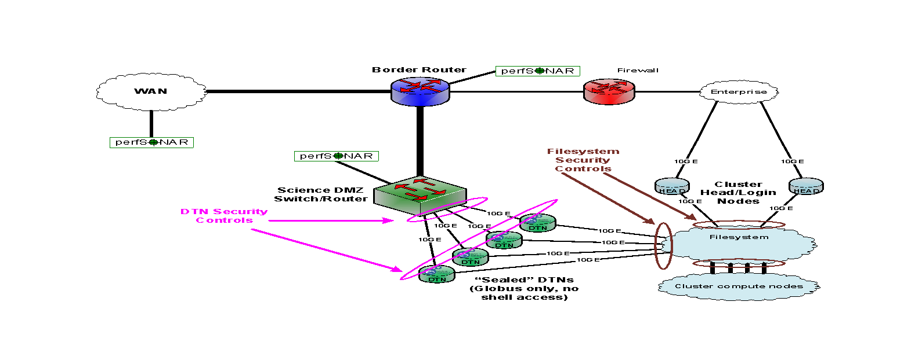
DTNs in a Facility – Security
10G
10G
10G
40G/100G
Downstream
Notes:
Next two classes are the same from a systems perspective
(main different from a workflow perspective—i.e. double copy workflow for SANs but not with distributed/global file systems)
We see these storage architectures in DTNs at data and HPC facilities
But whatever you choose for storage will depend on your environment, requirements, and resources.
______________________
System reasoning: what kind of card used on the backend to the storage system—FC/Ethernet/Inifiniband look the same
But the workflow is what’s different
No block device communication between DTN kernel Global fs
For SAN and internal disks—DTN kernel sees it as “owning”/managing blocks in SAN or RAID
_____________________________
Distributed file systems—high quality of service
much more reliable
easy to manage
however, typically performance is much lower because they are usually a shared system—don’t know the workload of other users—possibility of contesting traffic
i.e., we see this at data centers/supercomputers
they do have bottlenecks. I/O is the storage controller (EMC is limited to 8G right now)
Same I/O capacity but no bottleneck with infiniband connections.
enterprise level system
IB
56 G/link and easy to aggregate
reliable networking—no packet loss
fairly cheap
Distributed filesystem: this is similar to the storage system, except that the exported volumes are not RAW but file system (PNFS, Lustre, GPFS…). This set up is typical of a tiered system: data is acquired and processed, and stored. Then the DTN read from the shared storage.
Storage Systems: These are usually more massive systems (EMC, Netapp, DDN, etc) providing raw volumes to servers. The connectivity is usually fiber, but it can also be infiniband and ethernet.
This class benefits storage capacity.
POINT: look at what your infrastructure requirements are
how much capacity do you need for the next 3 years—will your system scale the way you want?
how reliable does your storage have to be—source of truth or is it a pain to resend the data if a disk goes down? (i.e., choose your RAID appropriately)
performance of storage what you need? If its 10G—laptops won’t do that
don’t need to invest in super fast storage if you only want to use laptops

Slide 12
Storage Subsystem Selection
Deciding what storage to use in your DTN is based on what you are optimizing for:
performance, reliability, capacity, and/or cost
SATA disks historically have been cheaper and higher capacity, while SAS disks typically have been the fastest.
Technologies have been converging (and its hard to keep up)
Do what you can support well (ditto for filesystems – ZFS, ext4, etc.)
Support is more than just what a vendor supports
Internal talent can be the deciding factor more often than not
Notes:
Now we are assuming you’ve chosen to go with internal disks/storage for your DTN
Deciding what storage to use in your DTN is based on what you are optimizing for:
performance, reliability, capacity, or cost.
SATA disks historically have been cheaper and higher capacity, while SAS (SCSI) disks typically have been the fastest.
Technologies have been converging (and its hard to keep up)
SATA (lower quality) was more for consumers and SAS for enterprise
SATA 3 is coming up to speed with SAS performance though
POINT: Choose what you can support well
_____________________________
SATA vs. SAS
Currently no particular reason to choose one over the other
SATA used to be much lower than SAS for performance
With SATA 3 it is comparable performance now
(SATA/SAS drives to RAID controller)
Historically
SATA (lower quality) was more for consumers and SAS for enterprise
Check SATA3!
[SAS/SATA bus that connects computer storage to drives
SAS backplanes are backward compatible with SATA but not SATA 3]
SATA3 and SAS are multipath I/O so roughly the same performance now but SAS is still recommended for non-consumer based workflows.

Slide 13
SSDs and HDs
SSD storage costs much more than traditional hard drives (HDs), but are much faster. They come in different styles:
PCIe card: some vendors (Fusion-IO) build PCI cards with SSDs.
These are the fastest type of SSD: up to several GBytes/sec per card.
Note that this type of SSD is typically not hot-swapable.
HD replacement: several vendors now sell SSD-based drives that have the same form factor as traditional drives such as SAS and SATA.
The downside to this approach is that performance is limited by the RAID controller, and not all controllers work well with SSD.
Be sure that your RAID controller is “SSD capable”.
NVME is the new kid on the block and prices are coming down.
Note that the price of SSD is coming down quickly, so an SSD-based solution may be worth considering for your DTNs.
Notes:
SSDs have usually been more expensive than HDs
prices are coming down though
SSDs do come in a few different shapes now:
On PCI cards (these are by far the fastest but they are the most expensive)
And as HD replacements: several vendors now sell SSD-based drives that have the same form factor as traditional drives such as SAS and SATA.
The downside to this approach is that performance is limited by the RAID controller, and not all controllers work well with SSD.
Be sure that your RAID controller is “SSD capable”.
_____________________________________
SSD have much less capacity/performance
every vendor has a different way of dealing with SSDs
some read fast but are WAY slower to write—slower than a hard drive
I.e., 97 GB/sec read with a 20GB/sec write—this is not optimal for a read/write workflow
i.e. laptop mostly does read
SSDs more geared to commodities right now—not great for high performance right now
SSDs not for everyone
Have to go back to WHAT IS YOUR WORKFLOW—i.e., bioinformatics use case with mostly reads, SSDs could be a good choice
For a lot of writes like a beamline at a light source, hard drives may be better
SSDs come in a lot of different packaging
One of the pros for SSDs are that they are good for plug and play
make sure that your RAID controller can deal with SSDs though because it is not always the same for every level

Slide 14
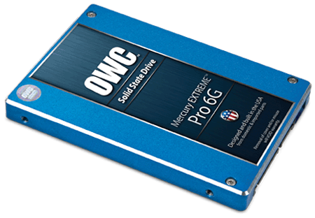
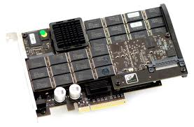
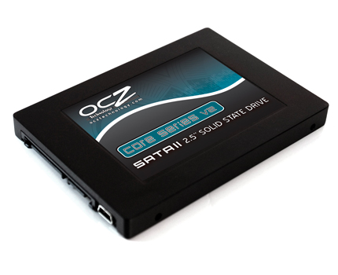
SSD Form Factors
Notes:
Fusion-io with SSDs on PCI cards (go directly to the CPU)
Left: two form factor replacements for HDs
Please note that performance/longevity of the SSD HD replacements is not great
They have a tendency to fail faster
also performance is unreliable: from 1GB to 100MB/s because they use more power, therefore heat up faster, and slowdown
______________________________
SSD $$ is becoming interesting—10X faster than the hard drive
not going to pay more for SSD performance
Performance/$$ is the same
But the catch is CAPACITY is not the same!
_____________________
Right side picture—PCIe card with SSD (this is what Fusion IO is doing this—the best for performance but pretty pricey--8TB was $120,000 last time we checked)
1TB available/card
max performance of an SSD—then no RAID controller in the path—goes directly to CPU
Form factor SSDs fail faster (examples shown on the left side)
SSD performance is not predictable
uses more power than a physical drive
they warm up much more to a point where systems cannot cool them down
internal measurement in systems and the SSDs will slow down (killing performance)
Slow down from 1GBs to 100MB/s—becomes super slow—therefore it is harder to predict how fast your I/O is going to be
On the other hand,
Hard drives are predictable and cooled
_______________________________
SSD, cost much more than HD, but a much faster. They come in different packages:
PCIe card: some vendors (Fusion I/O) build PCI cards with SSD. The current maximum capacity is 1TB per card. Since those cards are PCIe, the data transfer between the main memory and the SSD is just limited by the SSD speed and the PCIe speed: in other words, it is really fast (several GB/sec per card). The drawbacks are that 1TB uses a PCIe slot. This design often means that a PCI extender is needed, but if space and performance is an issue, this is the best solution. Those SSD cards can also be an deployment issue: replacing a failed card means that the server must be open.
- HD replacement: some vendors (IBM, WD, etc) have product that a physical replacement for HD: same form factor, same connectivity (SAS, SATA…). This allows for easier migration path from HD to SSD, but the performance is limited by the controller. Also, not all controllers are good at controlling SSD drives: always make sure that the controller is “SSD capable”.

Slide 15
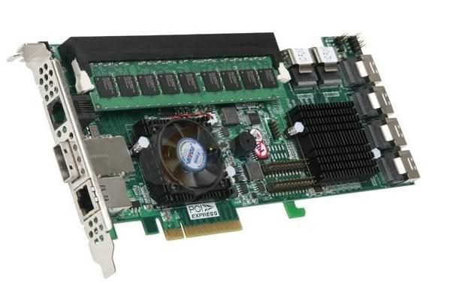
RAID Controllers
Often optimized for a given workload, rarely for performance.
RAID0 is the fastest of all RAID levels but is also the least reliable.
The performance of the RAID controller is a factor of the number of drives and its own processing engine.
Notes:
In general, RAID controllers are often optimized for a given workload, rarely for performance.
Trade-offs between reliability and speed.
(Disk controllers, RAID or not, are usually designed for “entreprise”.) This usually means that the controller is often configured with RAID 5 or 6.
RAID0 is the fastest of all RAID levels but is also the least reliable.
As a consequence, controllers are most of the time not capable of running all the drives at full speed:
A rule of thumb is that if a controller is said to handle up to X drives, it can handle up to 2/3 X drivers at full speed.

Slide 16
RAID Controller
Be sure your RAID controller has the following:
>= 1GB of on-board cache
PCIe Gen3 support (and your board can support that)
dual-core RAID-on-Chip (ROC) processor if you will have more than 8 drives
Notes:
Some high end controllers (Areca for instance) are specifically designed for a workflow similar to a DTN workflow: sequential read/write. They may have Gigabytes of SRAM for internal buffering, PCIe x16..
Finally, some RAID controllers are specifically designed to scale up. In addition to wire internal drives, they can control external drives, directly or in a daisy chain manner

Slide 17
Network Subsystem Selection
There is a huge performance difference between cheap and expensive 10G/40G NICs.
E.g. please don’t cheap out on the NIC – it’s important for an optimized DTN host.
NIC features to look for include:
support for interrupt coalescing
support for MSI-X
TCP Offload Engine (TOE)
support for zero-copy protocols such as RDMA (RoCE or iWARP)
Note that many 10G/40G/100G NICs come in dual ports, but that does not mean if you use both ports at the same time you get double the performance. Often the second port is meant to be used as a backup port.
Myricom 10G-PCIE2-8C2-2S
Mellanox MCX312A-XCBT
Mellanox ConnectX-3 , ConnectX-4
Notes:
Last thing in the hardware queue is to think about the Network subsystem
Networking subsystem is the second subsystem after the storage that is critical and could be a major bottle neck.
The choice of your NIC(s) will impact performance.
There is a huge performance difference between cheap and expensive 10G NICs.
E.g. please don’t cheap out on the NIC – it’s important for an optimized DTN host.
NIC features to look for include:
support for interrupt coalescing
support for MSI-X
TCP Offload Engine (TOE)
support for zero-copy protocols such as RDMA (RoCE or iWARP)
Note that many 10G and 40G NICs come in dual ports, but that does not mean if you use both ports at the same time you get double the performance. Often the second port is meant to be used as a backup port.
True 2x10G capable cards include the Myricom 10G-PCIE2-8C2-2S and the Mellanox MCX312A-XCBT.

Slide 18
Reference Implementation (2023)
Hardware description
The total cost of this server was around $25K in late 2022. These systems be deployed to ESnet in late 2022 and into 2023 for ESnet6
Base System: Supermicro 2124US-TNRP 2U dual AMD socket SP3 server
onboard VGA, dual10G RJ45, dual10G SFP+, onboard dedicated IPMI RJ45
1 PCI-E 4.0 x16 slot,
24 front access NVME hotswap bays
dual redundant hotswap 1200W PSU
2x AMD EPYC Milan 73F3
16 cores each
3.5Ghz 240W TDP processor
256 GB RAM - 16x 16G DDR4 3200 ECC RDIMM
800G System Disk: 2x Micron 7300 MAX 800G U.2/2.5" NVME
25TB Data Disk: 10x Micron 9300 MAX 3.2TB U.2/2.5" NVME
NVIDIA MCX613106A-VDAT ConnectX-6 EN Adapter Card 200GbE
Mellanox MMA1L10-CR Optical Transceiver 100GbE QSFP28 LC-LC 1310nm LR4 up to 10km
OOB license for IPMI management
2x 1300W -48V DC PSU OR 2x 1200W AC PSU
Notes:
Last thing in the hardware queue is to think about the Network subsystem
Networking subsystem is the second subsystem after the storage that is critical and could be a major bottle neck.
The choice of your NIC(s) will impact performance.
There is a huge performance difference between cheap and expensive 10G NICs.
E.g. please don’t cheap out on the NIC – it’s important for an optimized DTN host.
NIC features to look for include:
support for interrupt coalescing
support for MSI-X
TCP Offload Engine (TOE)
support for zero-copy protocols such as RDMA (RoCE or iWARP)
Note that many 10G and 40G NICs come in dual ports, but that does not mean if you use both ports at the same time you get double the performance. Often the second port is meant to be used as a backup port.
True 2x10G capable cards include the Myricom 10G-PCIE2-8C2-2S and the Mellanox MCX312A-XCBT.

Slide 19
Reference Implementation (2020)
Hardware description
The total cost of this server was approximately $21K in mid 2019
Base System: Gigabyte R281-NO0 dual socket P 2U server
Onboard: VGA, 2 x GbE RJ45 Intel i350, IPMI dedicated LAN
24 x front access U.2 hotswap bays
2 x rear access 2.5” SATA hotswap bays
Dual redundant hotswap 1600W PSU
2 x Intel Cascade lake Xeon Gold 6246
12 cores each
3.3GHz 165W TDP processor
12 x 16G DDR4 2933 ECC RDIMM (192G total)
10 x Intel P4610 1.6TB U.2/2.5” PCIe NVMe 3.0 x4 Drives (connect directly to CPU for VROC)
2 x Enterprise 960G 2.5“ SATA SSD (OS, onboard Intel SATA Raid 1)
VIntel® Virtual RAID On CPU (VROC) RAID 0, 1, 10, 5
Mellanox ConnectX-5 EN MCX516A-CCAT 40/50/100GbE dual-port QSFP28 NIC
Notes:
Last thing in the hardware queue is to think about the Network subsystem
Networking subsystem is the second subsystem after the storage that is critical and could be a major bottle neck.
The choice of your NIC(s) will impact performance.
There is a huge performance difference between cheap and expensive 10G NICs.
E.g. please don’t cheap out on the NIC – it’s important for an optimized DTN host.
NIC features to look for include:
support for interrupt coalescing
support for MSI-X
TCP Offload Engine (TOE)
support for zero-copy protocols such as RDMA (RoCE or iWARP)
Note that many 10G and 40G NICs come in dual ports, but that does not mean if you use both ports at the same time you get double the performance. Often the second port is meant to be used as a backup port.
True 2x10G capable cards include the Myricom 10G-PCIE2-8C2-2S and the Mellanox MCX312A-XCBT.

Slide 20
Reference Implementation (2020)
Preliminary System Performance Results for this configuration
Initial system performance was evaluated utilizing two identical units, and a topology that consisted of:
Back-to-back 40Gbps active cable
40Gbps local to 100Gbps WAN connection(s) with an RTT of 40ms (Berkeley CA to Chicago IL, round trip)
The testing was performed on Ubuntu 18.04 using XFS on mdraid with O_DIRECT and standard POSIX I/O. The file sizes varied between 256 GB and 1T with consistent results between file sizes, as well as consistent results when writing pseudo-random data vs all-zeroes.
Testing revealed it was possible to maintain a sustained total of 80Gbps on both connections of the NIC. Future testing will focus on the use of 100Gbps cable cables and optics.
Notes:
Last thing in the hardware queue is to think about the Network subsystem
Networking subsystem is the second subsystem after the storage that is critical and could be a major bottle neck.
The choice of your NIC(s) will impact performance.
There is a huge performance difference between cheap and expensive 10G NICs.
E.g. please don’t cheap out on the NIC – it’s important for an optimized DTN host.
NIC features to look for include:
support for interrupt coalescing
support for MSI-X
TCP Offload Engine (TOE)
support for zero-copy protocols such as RDMA (RoCE or iWARP)
Note that many 10G and 40G NICs come in dual ports, but that does not mean if you use both ports at the same time you get double the performance. Often the second port is meant to be used as a backup port.
True 2x10G capable cards include the Myricom 10G-PCIE2-8C2-2S and the Mellanox MCX312A-XCBT.

Slide 21
Reference Implementation (2020)
Disk configuration effects on performance
The test systems have employed several disk configurations which were somewhat more complicated:
Using RAID-0, the best results were 126 Gbps write and 140 Gbps read with 8 disks on a single controller (PCIe multiplexor).
Current research is to increase the number of disks to 10 (with hopes of getting 155Gbps of raw performance) through re-arranging the disk placement on the PCIe multiplexor
PCIe bandwidth is roughly 1 GBps per PCIe lane, thus balancing across multiple drives is required to ensure peak performance.
The best preliminary storage results with parity are using mirroring in a RAID-10. The raw performance (to disk) is the same as above, but the effective write performance drops to about 60Gbps due to the resiliency requirements.
Notes:
Last thing in the hardware queue is to think about the Network subsystem
Networking subsystem is the second subsystem after the storage that is critical and could be a major bottle neck.
The choice of your NIC(s) will impact performance.
There is a huge performance difference between cheap and expensive 10G NICs.
E.g. please don’t cheap out on the NIC – it’s important for an optimized DTN host.
NIC features to look for include:
support for interrupt coalescing
support for MSI-X
TCP Offload Engine (TOE)
support for zero-copy protocols such as RDMA (RoCE or iWARP)
Note that many 10G and 40G NICs come in dual ports, but that does not mean if you use both ports at the same time you get double the performance. Often the second port is meant to be used as a backup port.
True 2x10G capable cards include the Myricom 10G-PCIE2-8C2-2S and the Mellanox MCX312A-XCBT.

Slide 22
Reference Implementation (2020)
CPU & Memory effects on performance
Testing has revealed that not all 12 cores (on a single chip) are activated regularly, unless the degree of parallelism increases. Busy DTN requirements will push up this requirement. Populating all memory channels in the RAM configuration also ensures peak performance, as the system is able to fully utilize and balance load as needed.
Notes:
Last thing in the hardware queue is to think about the Network subsystem
Networking subsystem is the second subsystem after the storage that is critical and could be a major bottle neck.
The choice of your NIC(s) will impact performance.
There is a huge performance difference between cheap and expensive 10G NICs.
E.g. please don’t cheap out on the NIC – it’s important for an optimized DTN host.
NIC features to look for include:
support for interrupt coalescing
support for MSI-X
TCP Offload Engine (TOE)
support for zero-copy protocols such as RDMA (RoCE or iWARP)
Note that many 10G and 40G NICs come in dual ports, but that does not mean if you use both ports at the same time you get double the performance. Often the second port is meant to be used as a backup port.
True 2x10G capable cards include the Myricom 10G-PCIE2-8C2-2S and the Mellanox MCX312A-XCBT.

Slide 23
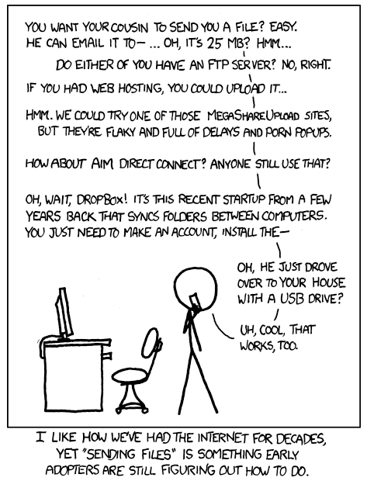
Take Home Points
The 2 key “take homes” for hardware are:
Needs to be expandable and
Needs to be supportable
Needs to be able to seamlessly support data mobility
Notes:
It is important to pay attention to the hardware
Hardware is especially important because you can be stuck with long-lasting performance bottlenecks if you’re not careful with
components that are incompatible,
have wrong interfaces
or run out of capacity
Want to make sure the hardware you choose/purchase is
-Expandable for future needs at least 3-5 years out
-and supportable—because backyard concoctions can be hard to work with…

Slide 24
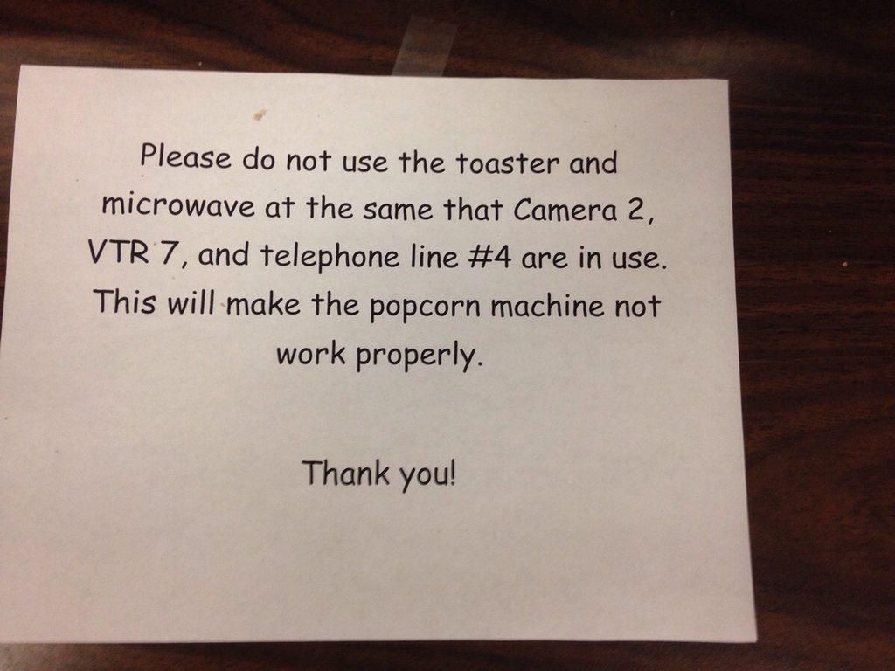
DTN Tuning is Art & Science
Notes:
What composes a DTN
A DTN server is made of several subsystems:
Storage
Networking
Motherboard
Chassis
Each needs to perform optimally for the DTN workflow—any of these things components can be the bottleneck if you’re not careful
There is always one thing that prevents you from going faster—eliminate as many bottlenecks as possible with hardware as a start
Only job is big sequential writes and big sequential reads—large file IO
_______________
Also please note the workflow we are optimizing for here is
sequential reads/write of large files, and a moderate number of high bandwidth flows.
A Data Transfer Node is not a processing, rendering, server. Its only workflow is:
Sender host:
1) read data from the storage subsystem
2) send it to the receiver host
Receiver host:
1) read data from the network
2) write it onto the storage subsystem

Slide 25
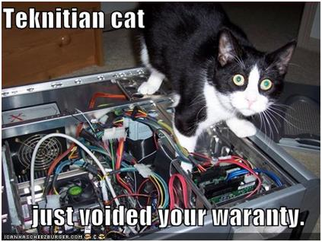
DTN Tuning http://fasterdata.es.net/science-dmz/DTN/tuning
Defaults are not appropriate for performance.
What needs to be tuned:
BIOS
Firmware
Device Drivers
Networking
File System
Application

Slide 26
DTN Tuning
Tuning your DTN host is extremely important. We have seen overall IO throughput of a DTN more than double with proper tuning.
Tuning can be as much art as a science. Due to differences in hardware, its hard to give concrete advice.
Here are some tuning settings that we have found do make a difference.
This tutorial assumes you are running a RedHat-based Linux system, but other Unix flavors should have similar tuning knobs.
Note that you should always use the most recent version of the OS, as performance optimizations for new hardware are added to every release.

Slide 27
Network Tuning
# add to /etc/sysctl.conf
net.core.rmem_max = 67108864
net.core.wmem_max = 67108864
net.ipv4.tcp_rmem = 4096 87380 33554432
net.ipv4.tcp_wmem = 4096 65536 33554432
net.core.netdev_max_backlog = 250000
Add to /etc/rc.local to increase send queue depth
# increase txqueuelen
/sbin/ifconfig eth2 txqueuelen 10000
/sbin/ifconfig eth3 txqueuelen 10000
This info (and more) is available on fasterdata, formatted for cut and paste
# make sure cubic and htcp are loaded
/sbin/modprobe tcp_htcp
/sbin/modprobe tcp_cubic
# set default to CC alg to htcp
net.ipv4.tcp_congestion_control=htcp
# with the Myricom 10G NIC
# using interrupt coalencing helps a lot:
/usr/sbin/ethtool -C ethN rx-usecs 75
Please consider jumbo frames, but don’t just blindly turn them on
Notes:
interrupt coalencing is used to avoid flooding the host system with too many interrupts, packets are collected and one single interrupt is generated for multiple packets.
Not all NIC support it
75-100 micro-seconds timeout
Is critical for high performance NIC (10Gb, 40Gb…)

Slide 28
I/O Scheduler
The default Linux scheduler is the "fair" scheduler. For a DTN node, we recommend using the "deadline" scheduler instead.
To enable deadline scheduling, add "elevator=deadline" to the end of the "kernel' line in your /boot/grub/grub.conf file, similar to this:
kernel /vmlinuz-2.6.35.7 ro root=/dev/VolGroup00/LogVol00 rhgb quiet elevator=deadline

Slide 29
Interrupt Affinity
Interrupts are triggered by I/O cards (storage, network). High performance means lot of interrupts per second
Interrupt handlers are executed on a core
Interrupt handler is just code – it gets run for every interrupt
Cache effects matter (with lots of I/O we’re going to run that code a lot)
Depending on the scheduler, core 0 gets all the interrupts, or interrupts are dispatched in a round-robin fashion among the cores: both are bad for performance:
Core 0 get all interrupts: with very fast I/O, the core is overwhelmed and becomes a bottleneck
Round-robin dispatch: very likely the core that executes the interrupt handler will not have the code in its L1 cache.
Two different I/O channels may end up on the same core.

Slide 30
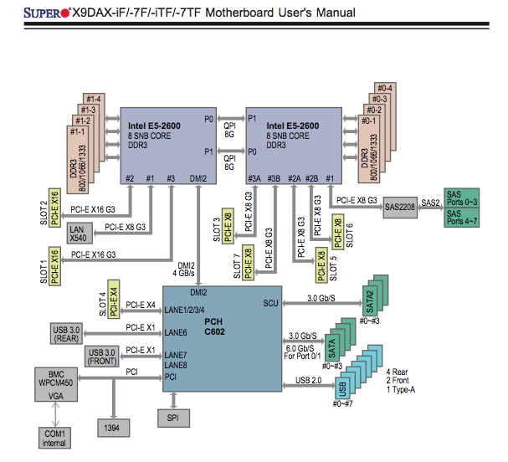
Know Your Layout
Where are your cards?
Where are your cores?
Understand what your bindings mean physically
Performance of a given config can be tightly coupled to physical layout
Don’t be afraid to experiment
Notes:
For interrupt binding, you need to know where the card is, and where the cores are.

Slide 31
SSD Issues – Write Sparingly
Tuning your SSD is more about reliability and longevity than performance
Each flash memory cell has a finite lifespan that is determined by the number of "program and erase (P/E)" cycles
Without proper tuning, SSD can die within months.
never do "write" benchmarks on SSD: this will damage your SSD quickly.
TRIM
Trim informs the SSD when the filesystem no longer needs space
Important to prolong the life of SSDs
Modern SSD drives and modern OSes should all include TRIM support
Only the newest RAID controllers included TRIM support as of late 2012
Swap
To prolong SSD lifespan, do not swap on an SSD
In Linux you can control this using the sysctl variable vm.swappiness. E.g.: add this to /etc/sysctl.conf:
vm.swappiness=1
This tells the kernel to avoid unmapping mapped pages whenever possible.
Avoid frequent re-writing of files (for example during compiling code from source), use a ramdisk file system (tmpfs) for /tmp /usr/tmp, etc.
Notes:
TRIM informs the disk when the filesystem has freed a block
More controllers should support TRIM now – however, make sure you check into this.

Slide 32
Benchmarking
Single-threaded sequential file write:
$ dd if=/dev/zero of=/storage/data1/file1 bs=4k count=33554432
Single-threaded sequential file read:
$ dd if=/storage/data1/file1 of=/dev/null bs=4k
Use more to simulate parallel workload
Use oflag=direct to disable caching

Slide 33
Sample Data Transfer Results (2005)
Using the right tool is very important
Sample Results: Berkeley, CA to Argonne, IL (near Chicago). RTT = 53 ms, network capacity = 10Gbps.
Tool Throughput
scp: 140 Mbps
HPN patched scp: 1.2 Gbps
ftp 1.4 Gbps
GridFTP, 4 streams 5.4 Gbps
GridFTP, 8 streams 6.6 Gbps
Note that to get more than 1 Gbps (125 MB/s) disk to disk requires RAID.

Slide 34
Say NO to SCP (2016)
Using the right data transfer tool is very important
Sample Results: Berkeley, CA to Argonne, IL (near Chicago ) RTT = 53 ms, network capacity = 10Gbps.
Notes
scp is 24x slower than GridFTP on this path!!
to get more than 1 Gbps (125 MB/s) disk to disk requires RAID array.
Assume host TCP buffers are set correctly for the RTT
Tool | Throughput
scp | 330 Mbps
wget, GridFTP, FDT, 1 stream | 6 Gbps
GridFTP and FDT, 4 streams | 8 Gbps (disk limited)

Slide 35
Data Transfer Tools
Parallelism is key
It is much easier to achieve a given performance level with four parallel connections than one connection
Several tools offer parallel transfers
Latency interaction is critical
Wide area data transfers have much higher latency than LAN transfers
Many tools and protocols assume a LAN
Examples: SCP/SFTP, HPSS mover protocol

Slide 36
Why Not Use SCP or SFTP?
Pros:
Most scientific systems are accessed via OpenSSH
SCP/SFTP are therefore installed by default
Modern CPUs encrypt and decrypt well enough for small to medium scale transfers
Credentials for system access and credentials for data transfer are the same
Cons:
The protocol used by SCP/SFTP has a fundamental flaw that limits WAN performance
CPU speed doesn’t matter – latency matters
Fixed-size buffers reduce performance as latency increases
It doesn’t matter how easy it is to use SCP and SFTP – they simply do not perform
Verdict: Do Not Use Without Performance Patches

Slide 37
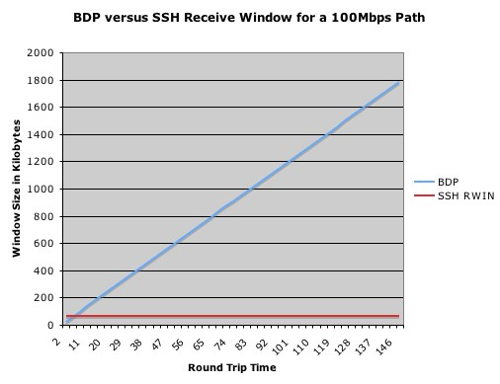
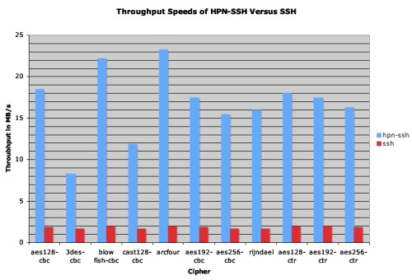
A Fix For scp/sftp
PSC has a patch set that fixes problems with SSH
http://www.psc.edu/networking/projects/hpn-ssh/
Significant performance increase (allows the TCP window to open up if the host is tuned)
Advantage – this helps rsync too

Slide 38
sftp
Uses same code as scp, so don't use sftp WAN transfers unless you have installed the HPN patch from PSC
But even with the patch, SFTP has yet another flow control mechanism
By default, sftp limits the total number of outstanding messages to 16 32KB messages.
Since each datagram is a distinct message you end up with a 512KB outstanding data limit.
You can increase both the number of outstanding messages ('-R') and the size of the message ('-B') from the command line though.
Sample command for a 128MB window:
sftp -R 512 -B 262144 user@host:/path/to/file outfile

Slide 39
Commercial Data Transfer Tools
There are several commercial UDP-based tools
Aspera: http://www.asperasoft.com/
Data Expedition: http://www.dataexpedition.com/
These should all do better than TCP on a lossy path
advantage of these tools less clear on an clean path
They all have different, fairly complicated pricing models

Slide 40
GridFTP
GridFTP from ANL has features needed to fill the network pipe
Buffer Tuning
Parallel Streams
Supports multiple authentication options
Anonymous
ssh
X509
Ability to define a range of data ports
helpful to get through firewalls
Partnership with ESnet and Globus Online to support Globus Online for use in Science DMZs

Slide 41
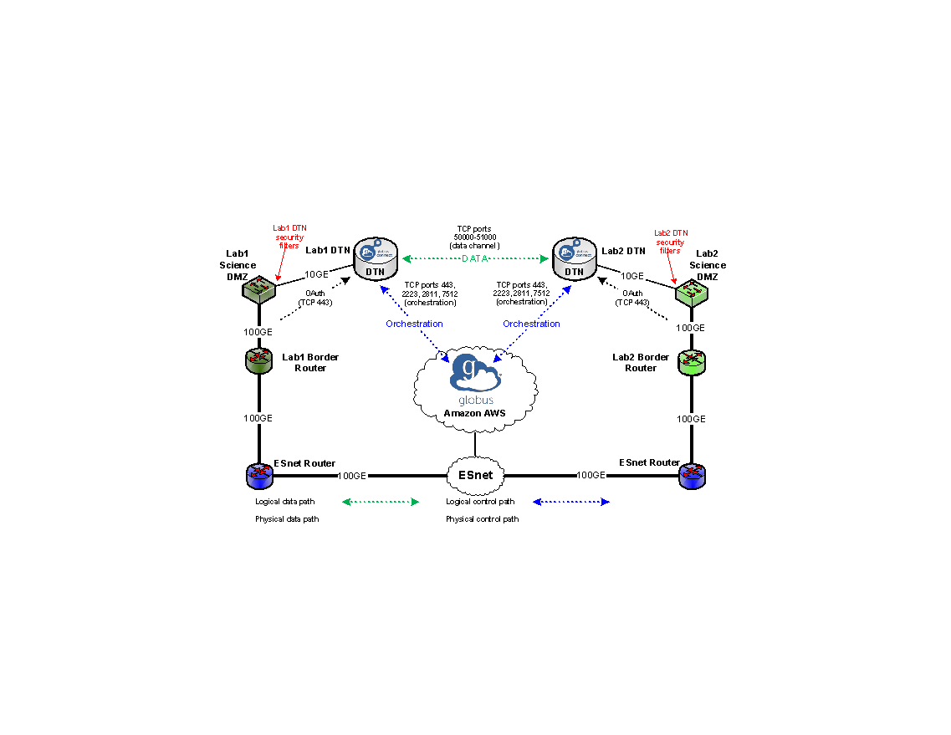

Slide 42
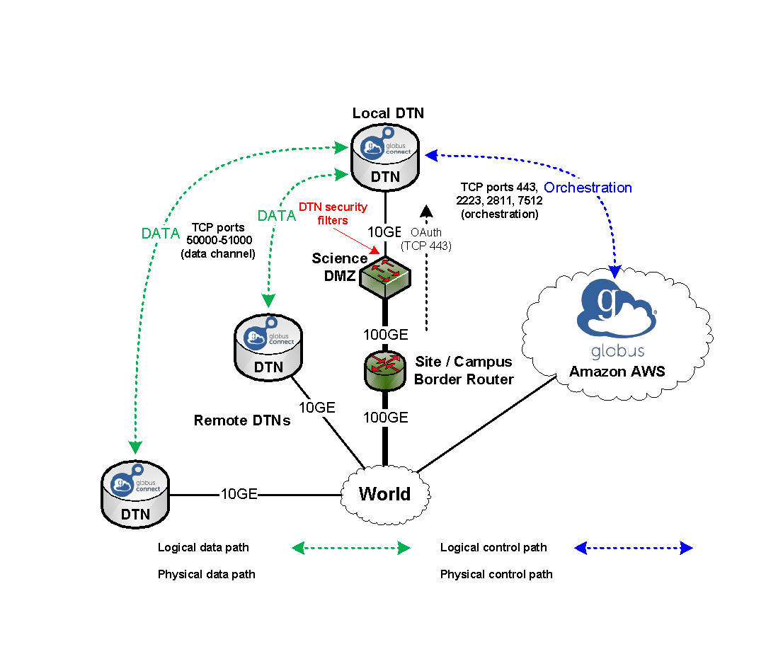

Slide 43
The End

